Slide 1

Mobile App Testing Automation: A Comprehensive Guide
This presentation will guide you through the process of setting up and implementing a mobile testing automation framework using a combination of powerful tools: Appium, Python, Sauce Labs, Pytest, and Jenkins. We'll cover everything from environment setup to test execution and reporting, empowering you to create efficient and reliable mobile testing workflows.

Slide 2
Introduction: Tools for Mobile Test Automation
Appium
Python
Sauce Labs
Pytest
Appium is a powerful open-source framework that enables cross-platform mobile test automation. It allows you to write tests in various languages (including Python) and execute them on both Android and iOS devices.
Python is a versatile programming language that excels in test automation due to its readability, extensive libraries, and robust ecosystem. It's a popular choice for Appium test development.
Sauce Labs provides a cloud-based platform for mobile and web testing. It offers a vast library of real devices and emulators, allowing you to test your applications on various configurations.
Pytest is a testing framework for Python that streamlines test writing and execution. It offers features like fixtures, parametrization, and reporting, enhancing test management.

Slide 3
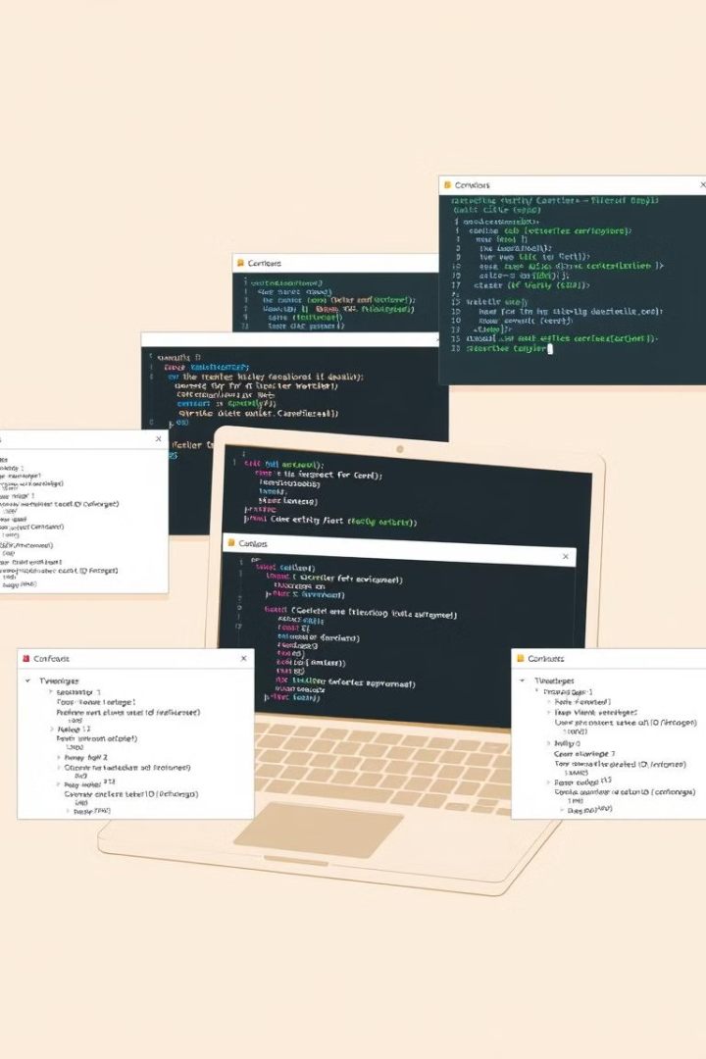
Setting Up the Testing Environment
Install Appium
Install Python
Download and install Appium Desktop for user-friendly test creation and management. You'll need a suitable version for your operating system.
Obtain the latest Python version for your system and ensure it's accessible on your command line. You'll use Python to write and execute Appium tests.
Install Pytest
Install Appium-Python-Client
Use `pip install pytest` to install Pytest, a powerful Python testing framework that enhances test organization and execution.
Install the Appium-Python-Client library using `pip install Appium-Python-Client`. It provides the necessary tools to interact with Appium.

Slide 4
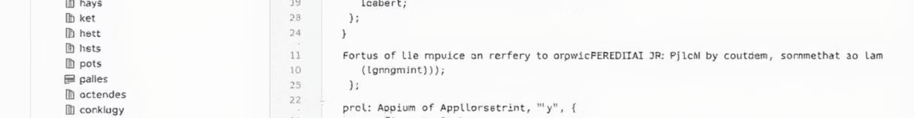




Writing Appium Tests in Python
Define Desired Capabilities
Specify the desired capabilities for your tests, such as platform, device, and application details. This will define the testing environment.
Create a Test Suite
Structure your tests in a well-organized manner using Pytest's conventions. Consider using test classes for better organization and reusability.
Implement Test Logic
Utilize Appium-Python-Client to interact with the app. Write test steps to simulate user interactions and verify expected behavior.
Assert Expected Outcomes
Use assertion statements within your test code to verify that the app behaves as expected. This ensures that your tests fail if there are errors.

Slide 5
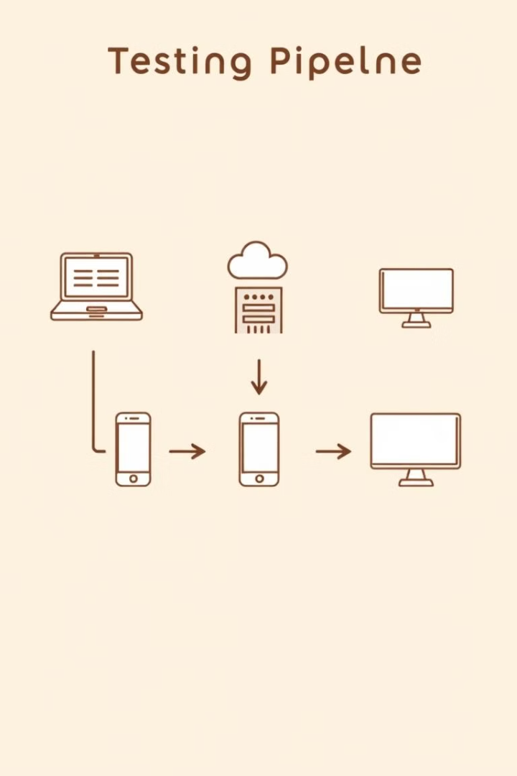
Integrating Appium Tests with Sauce Labs
1
2
Sauce Labs Account
Desired Capabilities
Create a Sauce Labs account to access their platform and explore their capabilities. This is the first step in using Sauce Labs.
Update your desired capabilities to connect to Sauce Labs and utilize their infrastructure for device and emulator access.
3
4
Execute Tests
Analyze Results
Run your tests using the Sauce Labs platform. This allows you to access a wide range of real devices and emulators for your testing.
Review the test results on the Sauce Labs platform. This gives you detailed insights into your tests, including screenshots and logs.

Slide 6
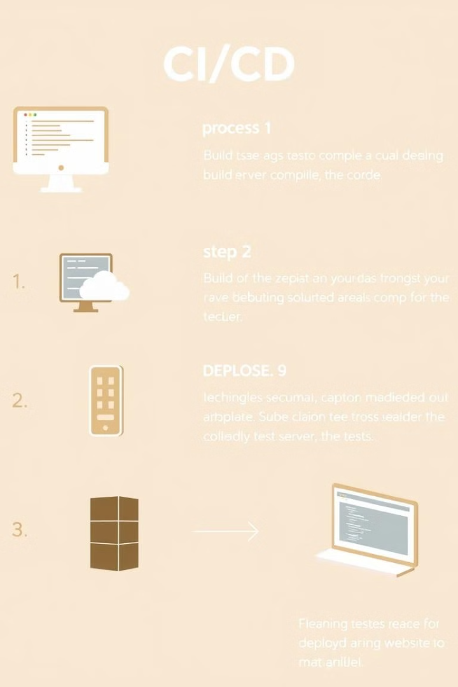
Continuous Integration with Jenkins
1
Install and configure Jenkins on your server. This will provide you with a platform to automate the build, test, and deployment process.
2
Create a Jenkins job for your Appium tests. Configure the job to build your project, run your tests, and report the results.
3
Integrate your Sauce Labs credentials into Jenkins. This will allow Jenkins to access Sauce Labs' platform and execute your tests.
4
Set up triggers to automatically run your tests on every code change. This ensures that your tests are run regularly and frequently.

Slide 7
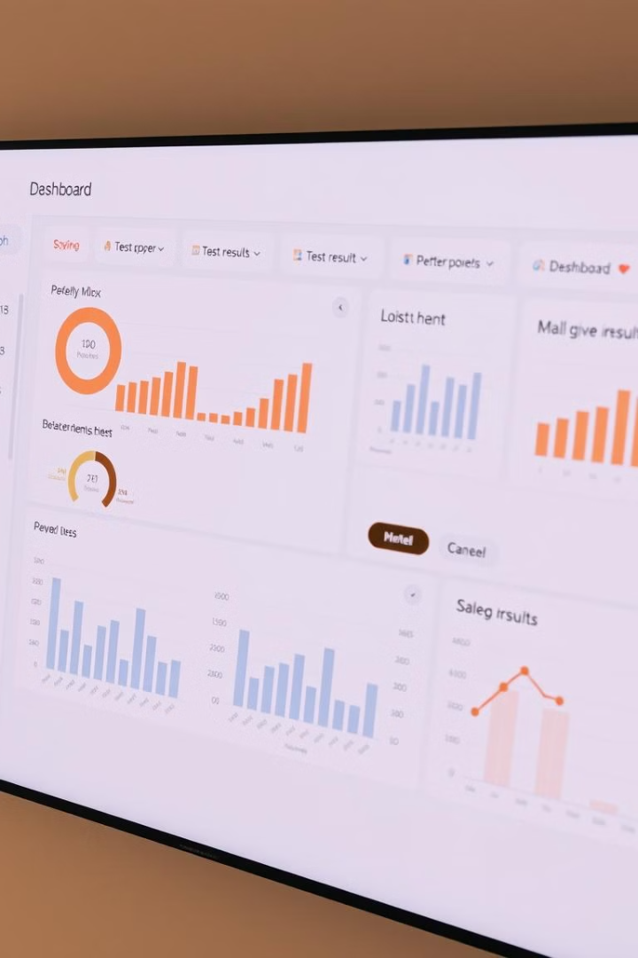



Reporting and Monitoring Test Results
Detailed Reports
Interactive Dashboards
Generate comprehensive reports of your test execution, including passed, failed, and skipped tests. This helps you track progress and identify issues.
Create interactive dashboards to visualize your test results over time. This helps you identify trends and monitor the health of your tests.
Real-Time Notifications
Set up alerts to notify you of any test failures. This helps you address problems quickly and prevent regressions.

Slide 8



Challenges and Best Practices
Scalability
1
Test execution time can increase as your test suite grows. Choose efficient test strategies and leverage cloud platforms.
Maintenance
2
Test automation requires ongoing maintenance to adapt to app changes. Implement effective test management practices.
Stability
3
Ensure your tests are reliable and do not fail due to external factors. Employ robust testing frameworks and best practices.

Slide 9

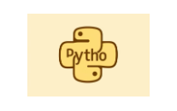

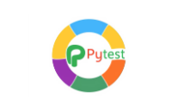

Conclusion and Next Steps
By leveraging the power of Appium, Python, Sauce Labs, Pytest, and Jenkins, you can create a robust mobile testing automation framework. This framework will streamline your testing process, increase efficiency, and improve the quality of your mobile applications.

